Slide 1
Design and Analysis of Algorithms
Algorithms-II : CS345A
Lecture 34
Solving the homework problems from the last lecture
Pattern Matching

Slide 2
RECAP of the Last Lecture

Slide 3

Theorem1:
We can compute transitive closure of graph $G$ in O$(n^{ω}\log{n})$ time.
How to get rid of log n factor ?
Work on the SCC graph of $G$

Slide 4

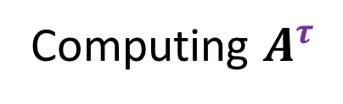


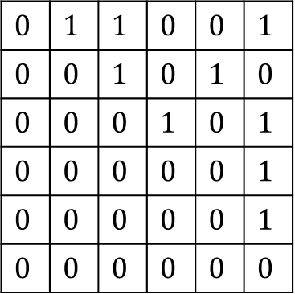


Computing $A^{τ}$
$$1$$ |  | $$…$$ |  |  | $$n$$
$$1$$
$$:$$
$$n$$
0
$$0$$ | $$1$$ | $$1$$ | $$0$$ | $$0$$ | $$1$$
$$0$$ | $$0$$ | $$1$$ | $$0$$ | $$1$$ | $$0$$
$$0$$ | $$0$$ | $$0$$ | $$1$$ | $$0$$ | $$1$$
$$0$$ | $$0$$ | $$0$$ | $$0$$ | $$0$$ | $$1$$
$$0$$ | $$0$$ | $$0$$ | $$0$$ | $$0$$ | $$1$$
$$0$$ | $$0$$ | $$0$$ | $$0$$ | $$0$$ | $$0$$
$$A$$
$$1 … \frac{n}{2} \frac{n}{2}+1 n$$
SCC($G$)

Slide 5



Computing $A^{τ}$
$$1$$ |  | $$…$$ |  |  | $$n$$
$$1$$
$$:$$
$$n$$
0
$$0$$ | $$1$$ | $$1$$ | $$0$$ | $$0$$ | $$1$$
$$0$$ | $$0$$ | $$1$$ | $$0$$ | $$1$$ | $$0$$
$$0$$ | $$0$$ | $$0$$ | $$1$$ | $$0$$ | $$1$$
$$0$$ | $$0$$ | $$0$$ | $$0$$ | $$0$$ | $$1$$
$$0$$ | $$0$$ | $$0$$ | $$0$$ | $$0$$ | $$1$$
$$0$$ | $$0$$ | $$0$$ | $$0$$ | $$0$$ | $$0$$
$$C$$
$$B$$
0
$$D$$
$$A$$
$$1 … \frac{n}{2} \frac{n}{2}+1 n$$

Slide 6



Computing $A^{τ}$
$$1$$ |  | $$…$$ |  |  | $$n$$
Compute$B^{τ}$
$$1$$
$$:$$
$$n$$
0
$$0$$ | $$1$$ | $$1$$ | $$0$$ | $$0$$ | $$1$$
$$0$$ | $$0$$ | $$1$$ | $$0$$ | $$1$$ | $$0$$
$$0$$ | $$0$$ | $$0$$ | $$1$$ | $$0$$ | $$1$$
$$0$$ | $$0$$ | $$0$$ | $$0$$ | $$0$$ | $$1$$
$$0$$ | $$0$$ | $$0$$ | $$0$$ | $$0$$ | $$1$$
$$0$$ | $$0$$ | $$0$$ | $$0$$ | $$0$$ | $$0$$
$$C$$
$$B$$
0
$$D$$
$$A$$
$$1 … \frac{n}{2} \frac{n}{2}+1 n$$
$$i$$
$$j$$

Slide 7



Computing $A^{τ}$
$$1$$ |  | $$…$$ |  |  | $$n$$
Compute$B^{τ}$
$$1$$
$$:$$
$$n$$
0
$$0$$ | $$1$$ | $$1$$ | $$0$$ | $$0$$ | $$1$$
$$0$$ | $$0$$ | $$1$$ | $$0$$ | $$1$$ | $$0$$
$$0$$ | $$0$$ | $$0$$ | $$1$$ | $$0$$ | $$1$$
$$0$$ | $$0$$ | $$0$$ | $$0$$ | $$0$$ | $$1$$
$$0$$ | $$0$$ | $$0$$ | $$0$$ | $$0$$ | $$1$$
$$0$$ | $$0$$ | $$0$$ | $$0$$ | $$0$$ | $$0$$
$$C$$
Compute$D^{τ}$
$$B$$
0
$$D$$
$$A$$
$$1 … \frac{n}{2} \frac{n}{2}+1 n$$
$$i$$
$$j$$

Slide 8






Computing $A^{τ}$
$$j$$
$$1$$ |  | $$…$$ |  |  | $$n$$
Compute$B^{τ}$
$$1$$
$$:$$
$$n$$
0
$C$
$$0$$ | $$1$$ | $$1$$ | $$0$$ | $$0$$ | $$1$$
$$0$$ | $$0$$ | $$1$$ | $$0$$ | $$1$$ | $$0$$
$$0$$ | $$0$$ | $$0$$ | $$1$$ | $$0$$ | $$1$$
$$0$$ | $$0$$ | $$0$$ | $$0$$ | $$0$$ | $$1$$
$$0$$ | $$0$$ | $$0$$ | $$0$$ | $$0$$ | $$1$$
$$0$$ | $$0$$ | $$0$$ | $$0$$ | $$0$$ | $$0$$
$$C$$
Compute$D^{τ}$
$$i$$
$$B$$
0
$$i$$
$$D$$
$$A$$
$$1 … \frac{n}{2} \frac{n}{2}+1 n$$
$$i$$
$$j$$
$$i→j$$

Slide 9







Computing $A^{τ}$
$$k$$
$$j$$
$$1$$ |  | $$…$$ |  |  | $$n$$
Compute$B^{τ}$
$$1$$
$$:$$
$$n$$
0
$C$
$$0$$ | $$1$$ | $$1$$ | $$0$$ | $$0$$ | $$1$$
$$0$$ | $$0$$ | $$1$$ | $$0$$ | $$1$$ | $$0$$
$$0$$ | $$0$$ | $$0$$ | $$1$$ | $$0$$ | $$1$$
$$0$$ | $$0$$ | $$0$$ | $$0$$ | $$0$$ | $$1$$
$$0$$ | $$0$$ | $$0$$ | $$0$$ | $$0$$ | $$1$$
$$0$$ | $$0$$ | $$0$$ | $$0$$ | $$0$$ | $$0$$
$$i$$
$$C$$
Compute$D^{τ}$
$$B$$
$$B^{τ}C$$
$$k$$
0
$$D$$
$$A$$
$$1 … \frac{n}{2} \frac{n}{2}+1 n$$
$$i$$
$$k$$
$$j$$
$i$ $⇝$ $k$
$$→j$$

Slide 10







Computing $A^{τ}$
$$k$$
$$j$$
$$1$$ |  | $$…$$ |  |  | $$n$$
Compute$B^{τ}$
$$1$$
$$:$$
$$n$$
0
$C$
$$0$$ | $$1$$ | $$1$$ | $$0$$ | $$0$$ | $$1$$
$$0$$ | $$0$$ | $$1$$ | $$0$$ | $$1$$ | $$0$$
$$0$$ | $$0$$ | $$0$$ | $$1$$ | $$0$$ | $$1$$
$$0$$ | $$0$$ | $$0$$ | $$0$$ | $$0$$ | $$1$$
$$0$$ | $$0$$ | $$0$$ | $$0$$ | $$0$$ | $$1$$
$$0$$ | $$0$$ | $$0$$ | $$0$$ | $$0$$ | $$0$$
$$i$$
$$C$$
Compute$D^{τ}$
$$B$$
$$B^{τ}C$$
$CD^{τ}$
0
$$k$$
$$D$$
$$A$$
$$1 … \frac{n}{2} \frac{n}{2}+1 n$$
$$i$$
$$k$$
$$j$$
$$i→k$$
$⇝$ $j$

Slide 11








Computing $A^{τ}$
$$1$$ |  | $$…$$ |  |  | $$n$$
Compute$B^{τ}$
$$1$$
$$:$$
$$n$$
0
$C$
$$0$$ | $$1$$ | $$1$$ | $$0$$ | $$0$$ | $$1$$
$$0$$ | $$0$$ | $$1$$ | $$0$$ | $$1$$ | $$0$$
$$0$$ | $$0$$ | $$0$$ | $$1$$ | $$0$$ | $$1$$
$$0$$ | $$0$$ | $$0$$ | $$0$$ | $$0$$ | $$1$$
$$0$$ | $$0$$ | $$0$$ | $$0$$ | $$0$$ | $$1$$
$$0$$ | $$0$$ | $$0$$ | $$0$$ | $$0$$ | $$0$$
$$C$$
Compute$D^{τ}$
$$B$$
$B^{τ}C$
$CD^{τ}$
0
$B^{τ}CD^{τ}$
$$D$$
$$A$$
$$1 … \frac{n}{2} \frac{n}{2}+1 n$$
$$i$$
$$p$$
$$k$$
$$j$$
$i$ $⇝$ $p$
$⇝$ $j$
$$→k$$

Slide 12

















Computing $A^{τ}$
$$1$$ |  | $$…$$ |  |  | $$n$$
Compute$B^{τ}$
$$+$$
$B^{τ}C$
$$+$$
$$1$$
$$:$$
$$n$$
0
$C$
$$+$$
$CD^{τ}$
$B^{τ}CD^{τ}$
$$0$$ | $$1$$ | $$1$$ | $$0$$ | $$0$$ | $$1$$
$$0$$ | $$0$$ | $$1$$ | $$0$$ | $$1$$ | $$0$$
$$0$$ | $$0$$ | $$0$$ | $$1$$ | $$0$$ | $$1$$
$$0$$ | $$0$$ | $$0$$ | $$0$$ | $$0$$ | $$1$$
$$0$$ | $$0$$ | $$0$$ | $$0$$ | $$0$$ | $$1$$
$$0$$ | $$0$$ | $$0$$ | $$0$$ | $$0$$ | $$0$$
$$C$$
Compute$D^{τ}$
$$B$$
${(I+B}^{τ})C$
$$+$$
$(I+ B^{τ})CD^{τ}$
0
$$D$$
$(I+ B^{τ})C(I+D^{τ})$
Compute$(I+ B^{τ})C(I+D^{τ})$
$$A$$
$$1 … \frac{n}{2} \frac{n}{2}+1 n$$
What is the time complexity of the algorithm ?
$$i$$
$$j$$
$$2 T\left(\frac{n}{2}\right)+c_{1}n^{ω}+c_{2}n^{2}$$
$$≤$$
${+ (c}_{1}+c_{2})n^{ω}$
$$T(n) =$$
$$=O(n^{ω})$$

Slide 13

Theorem:
We can compute transitive closure of graph $G$ in O$(n^{ω})$ time.

Slide 14

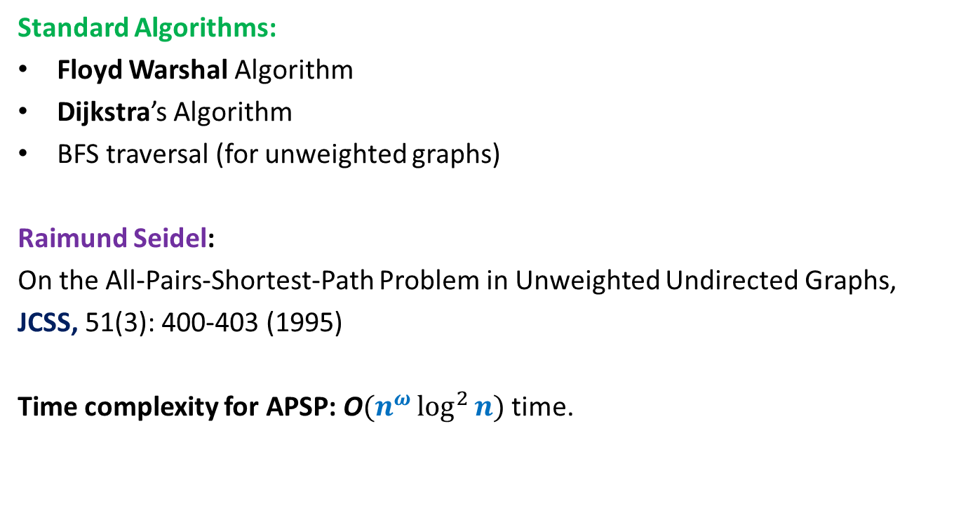
All Pairs Shortest Paths (APSP)
Matrix Multiplication
Standard Algorithms:
Floyd Warshal Algorithm
Dijkstra’s Algorithm
BFS traversal (for unweighted graphs)
Raimund Seidel:
On the All-Pairs-Shortest-Path Problem in Unweighted Undirected Graphs,
JCSS, 51(3): 400-403 (1995)
Time complexity for APSP: O$(n^{ω}\log^{2}{n})$ time.
O$(n^{3})$ time in the worst case

Slide 15

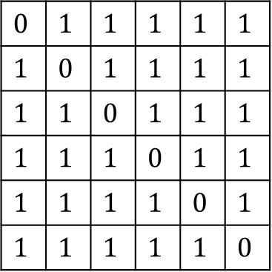


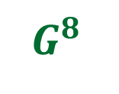
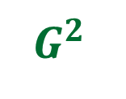
$$0$$ | $$1$$ | $$1$$ | $$1$$ | $$1$$ | $$1$$
$$1$$ | $$0$$ | $$1$$ | $$1$$ | $$1$$ | $$1$$
$$1$$ | $$1$$ | $$0$$ | $$1$$ | $$1$$ | $$1$$
$$1$$ | $$1$$ | $$1$$ | $$0$$ | $$1$$ | $$1$$
$$1$$ | $$1$$ | $$1$$ | $$1$$ | $$0$$ | $$1$$
$$1$$ | $$1$$ | $$1$$ | $$1$$ | $$1$$ | $$0$$
$$G$$
?
$G^{2}$
$G^{4}$
$G^{8}$
…
$$G^{n−1}$$

Slide 16
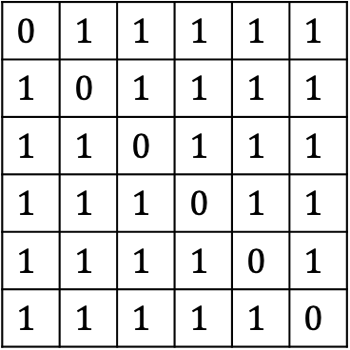

$$0$$ | $$1$$ | $$1$$ | $$1$$ | $$1$$ | $$1$$
$$1$$ | $$0$$ | $$1$$ | $$1$$ | $$1$$ | $$1$$
$$1$$ | $$1$$ | $$0$$ | $$1$$ | $$1$$ | $$1$$
$$1$$ | $$1$$ | $$1$$ | $$0$$ | $$1$$ | $$1$$
$$1$$ | $$1$$ | $$1$$ | $$1$$ | $$0$$ | $$1$$
$$1$$ | $$1$$ | $$1$$ | $$1$$ | $$1$$ | $$0$$
$$G$$
?
$G^{2}$
$G^{4}$
$G^{8}$
…
$$G^{n−1}$$

Slide 17

Question: Given distance matrix $D′$ of $G^{2}$,
how to compute distance matrix $D$ of $G$ ?

Slide 18










Distance in $G^{2}$ Distance in $G$
?
If $D_{ij}$is even ➔ ${D′}_{ij}$ = $\frac{D_{ij}}{2}$
If $D_{ij}$is odd ➔ ${D′}_{ij}$ = $\frac{D_{ij} + 1}{2}$
$$G^{2}$$
$$D′$$
$$i$$
$$j$$
$$G$$
$$D$$
$$i$$
$$j$$

Slide 19
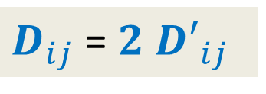
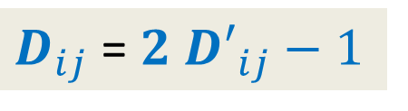
Distance in $G^{2}$ Distance in $G$
?
If $D_{ij}$is even ➔ ${D′}_{ij}$ = $\frac{D_{ij}}{2}$
If $D_{ij}$is odd ➔ ${D′}_{ij}$ = $\frac{D_{ij} + 1}{2}$
$D_{ij}$ = ${2 D′}_{ij}$
$D_{ij}$ = ${2 D′}_{ij}−1$
$$G^{2}$$
$$D′$$
$$G$$
$$D$$
$$i$$
$$j$$

Slide 20






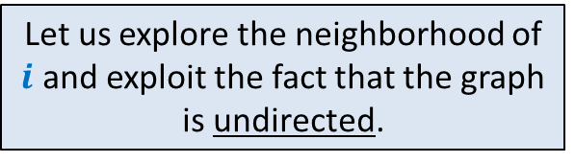


Let us explore the neighborhood of $i$ and exploit the fact that the graph is undirected.
Question: How to determine if $D_{ij}$is even or odd ?
$D_{ij}−1{≤D}_{kj}≤$ $D_{ij}+1$
$D_{ij}$is even ➔ For each neighbor $k$ of $i$
$D_{ij}$is odd ➔ For each neighbor $k$ of $i$
$${D′}_{kj}<{D′}_{ij}$$
$$k$$
What about this neighbor ?
?
$$G$$
$$i$$
$$j$$
$${D′}_{kj}≥{D′}_{ij}$$
$${D′}_{kj}≤{D′}_{ij}$$

Slide 21


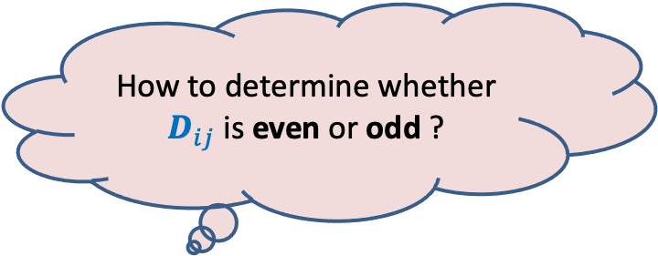

Theorem:
If $D_{ij}$is even, then for each neighbor $k$ of $i$ , ${D′}_{kj}≥{D′}_{ij}$
If $D_{ij}$is odd, then for each neighbor $k$ of $i$ , ${D′}_{kj}≤{D′}_{ij}$
AND there exists at least one neighbor $k$ such that ${D′}_{kj}<{D′}_{ij}$.
How to determine whether $D_{ij}$is even or odd ?
$$C$$
?
$$D′$$
Homework: Ponder over it. We shall discuss it in the next class.

Slide 22


















Theorem:
If $D_{ij}$is even, then for each neighbor $k$ of $i$ , ${D′}_{kj}≥{D′}_{ij}$
If $D_{ij}$is odd, then for each neighbor $k$ of $i$ , ${D′}_{kj}≤{D′}_{ij}$
AND there exists at least one neighbor $k$ such that ${D′}_{kj}<{D′}_{ij}$.
$${D′}_{aj}$$
$$≥$$
$${D′}_{ij}$$
$${D′}_{bj}$$
$$≥$$
$${D′}_{ij}$$
$$a$$
$${D′}_{pj}$$
$$≥$$
$${D′}_{ij}$$
$${D′}_{qj}$$
$$≥$$
$${D′}_{ij}$$
$$r$$
$$b$$
$${D′}_{rj}$$
$$≥$$
$${D′}_{ij}$$
$$i$$
$$C$$
?
$$D′$$
$$p$$
$$q$$
Homework: Ponder over it. We shall discuss it in the next class.

Slide 23


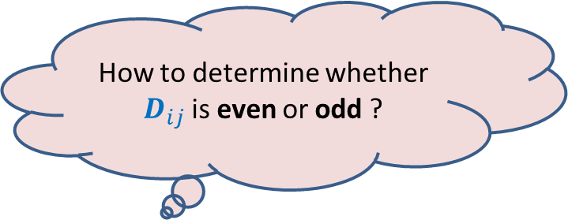
Theorem:
If $D_{ij}$is even, then for each neighbor $k$ of $i$ , ${D′}_{kj}≥{D′}_{ij}$
If $D_{ij}$is odd, then for each neighbor $k$ of $i$ , ${D′}_{kj}≤{D′}_{ij}$
AND there exists at least one neighbor $k$ such that ${D′}_{kj}<{D′}_{ij}$.
How to determine whether $D_{ij}$is even or odd ?
$${D′}_{aj}$$
$$≥$$
$${D′}_{ij}$$
$${D′}_{bj}$$
$$≥$$
$${D′}_{ij}$$
$$a$$
$${D′}_{pj}$$
$$≥$$
$${D′}_{ij}$$
$${D′}_{qj}$$
$$≥$$
$${D′}_{ij}$$
$$r$$
$$b$$
$${D′}_{rj}$$
$$≥$$
$${D′}_{ij}$$
$$i$$
$$j$$
$$p$$
$$q$$

Slide 24









Theorem:
If $D_{ij}$is even, then for each neighbor $k$ of $i$ , ${D′}_{kj}≥{D′}_{ij}$
If $D_{ij}$is odd, then for each neighbor $k$ of $i$ , ${D′}_{kj}≤{D′}_{ij}$
AND there exists at least one neighbor $k$ such that ${D′}_{kj}<{D′}_{ij}$.
$${D′}_{ij}$$
$$+ + + + + + + +$$
$×$deg($i$)
$${D′}_{aj}$$
$${D′}_{bj}$$
$${D′}_{pj}$$
$${D′}_{qj}$$
$${D′}_{rj}$$
$${D′}_{ij}$$
$${D′}_{ij}$$
$${D′}_{ij}$$
$${D′}_{ij}$$
$$≥$$
$$≥$$
$$a$$
$$≥$$
$$≥$$
$$r$$
$$b$$
$$≥$$
$$i$$
$$j$$
$$p$$
$$q$$

Slide 25

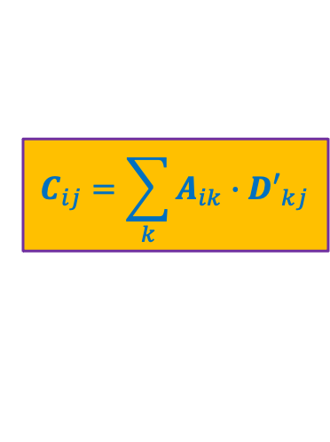










Theorem:
If $D_{ij}$is even, then for each neighbor $k$ of $i$ , ${D′}_{kj}≥{D′}_{ij}$
If $D_{ij}$is odd, then for each neighbor $k$ of $i$ , ${D′}_{kj}≤{D′}_{ij}$
AND there exists at least one neighbor $k$ such that ${D′}_{kj}<{D′}_{ij}$.
$${D′}_{ij}$$
$×$deg($i$)
$${D′}_{aj}$$
$${D′}_{bj}$$
$${D′}_{pj}$$
$${D′}_{qj}$$
$${D′}_{rj}$$
$${D′}_{ij}$$
$${D′}_{ij}$$
$${D′}_{ij}$$
$${D′}_{ij}$$
$$+ + + + + + + +$$
$$≥$$
$${D′}_{aj}$$
$${D′}_{bj}$$
$${D′}_{pj}$$
$${D′}_{qj}$$
$${D′}_{rj}$$
$$+ + + +$$
$$<$$
$${D′}_{ij}$$
$×$deg($i$)
$$a$$
$$r$$
$$b$$
$$C$$
?
$$D′$$
$$A$$
$$i$$
$$j$$
$$p$$
$$q$$
$$C_{ij}=\sum_{k}{A_{ik}{∙D′}_{kj}}$$
Compare $C_{ij}$ with ${D′}_{ij}⋅Z_{ii}$

Slide 26
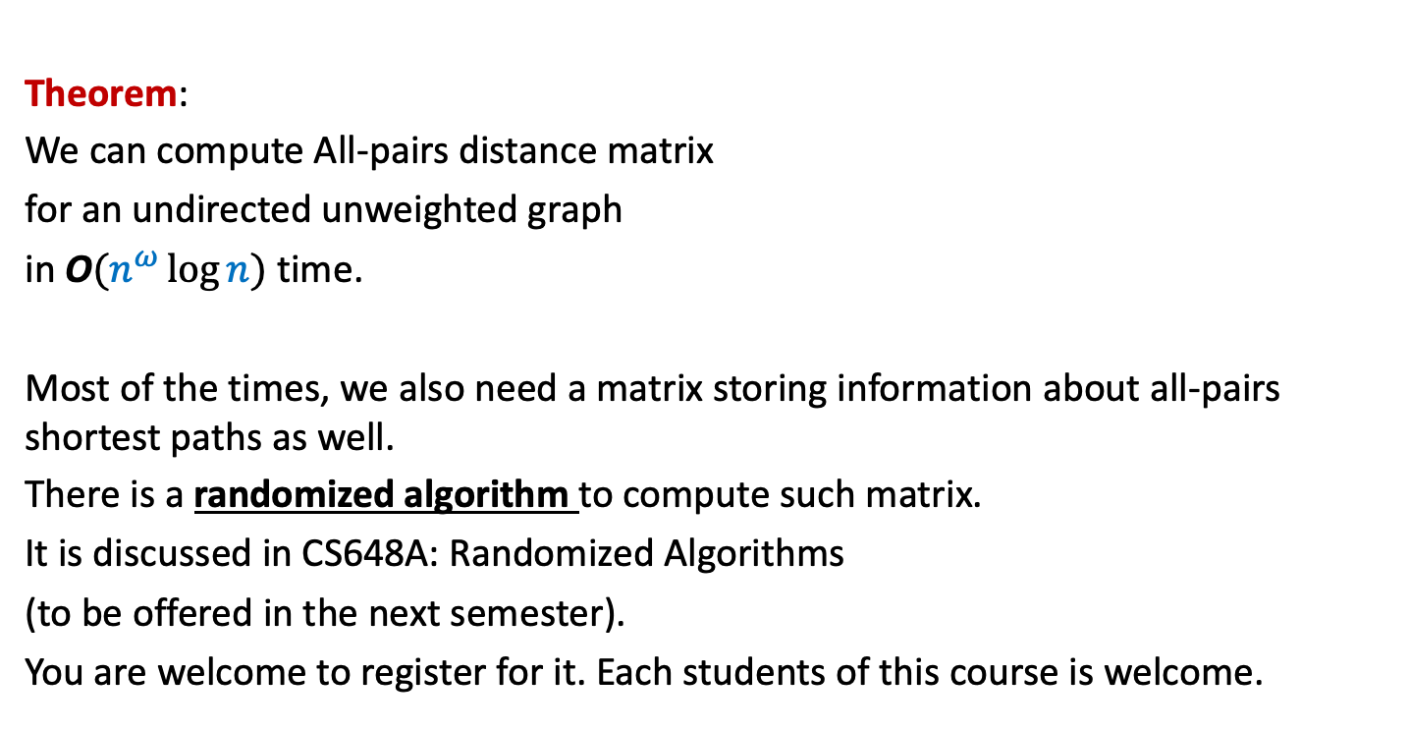
Theorem:
We can compute All-pairs distance matrix
for an undirected unweighted graph
in O$(n^{ω}\log{n})$ time.
Most of the times, we also need a matrix storing information about all-pairs shortest paths as well.
There is a randomized algorithm to compute such matrix.
It is discussed in CS648A: Randomized Algorithms
(to be offered in the next semester).
You are welcome to register for it. Each students of this course is welcome.

Slide 27
Pattern Matching

Slide 28

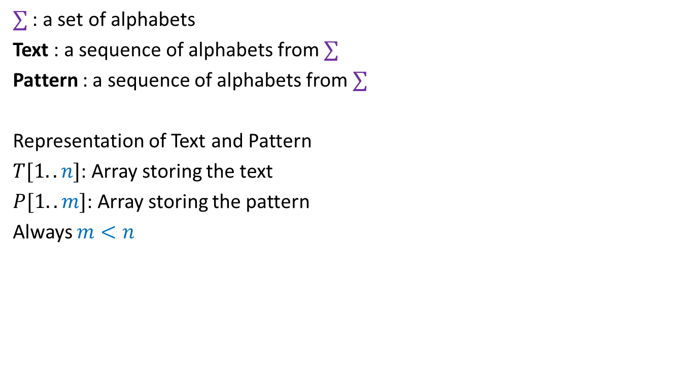

Problem Definition
$∑$ : a set of alphabets
Text : a sequence of alphabets from $∑$
Pattern : a sequence of alphabets from $∑$
Representation of Text and Pattern
$T[1..n]$: Array storing the text
$P[1..m]$: Array storing the pattern
Always $m<n$
$$T$$
a a b a c a a b a a a b a a b b c . . .
$$P$$
a a b a a
a a b a a
a a b a a

Slide 29









Problem Definition
$$1$$
$$i$$
$$n$$
Definition: Pattern matches Text at a location $i$ if
for $k=1$ to $m$, $P\left[k\right]=$ $T\left[ ? \right]$
Question: Find all occurrences of the pattern in the text.
$$T$$
$$P$$
$$1$$
$$m$$
$$i−m+k$$

Slide 30


First attempt
$$1$$
$$i$$
$$n$$
Definition: Pattern matches Text at a location $i$ if
for $k=1$ to $m$, $P\left[k\right]=$ $T\left[ ? \right]$
Question: Find all occurrences of the pattern in the text.
Observation: O($m$) time algorithm to check if $P$ occurs at $i$in $T$
Fact 1: This is also the best we can do for any given $i$.
O($mn$) time algorithm to find all occurrences of $P$ in $T$.
$$T$$
$$P$$
Does Fact 1 imply that we can’t achieve better than O($mn$) time ?
$$1$$
$$m$$
$$i−m+k$$
No.
The following slide will inspire you.

Slide 31

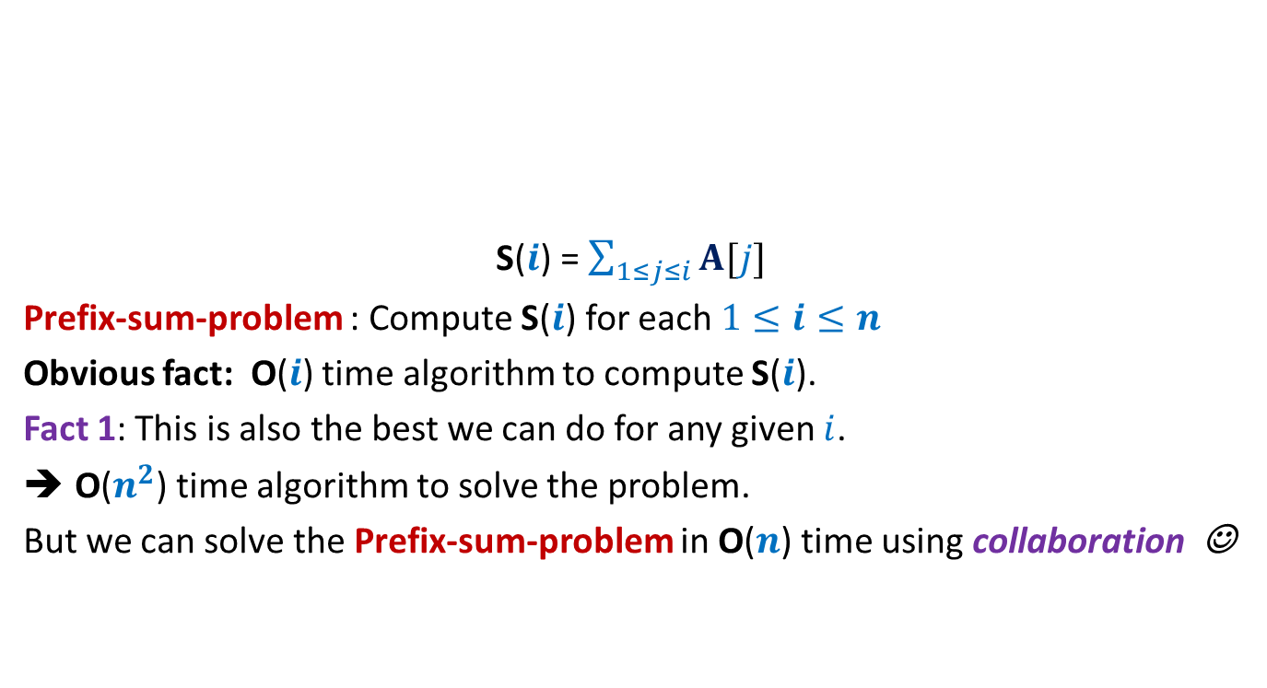
Prefix sum
$$i$$
S($i$) = $\sum_{1≤j≤i}{A[j]}$
Prefix-sum-problem : Compute S($i$) for each $1≤i≤n$
Obvious fact: O($i$) time algorithm to compute S($i$).
Fact 1: This is also the best we can do for any given $i$.
O($n^{2}$) time algorithm to solve the problem.
But we can solve the Prefix-sum-problem in O($n$) time using collaboration ☺
A
$$1$$ | $$5$$ | $$−3$$ | $$7$$ | $$9$$ | $$−8$$ | $$1$$ | $$3$$ | $$6$$ | $$−4$$ | $$8$$ | $$2$$
S($i$) = S($i−1$)+ A($i$)

Slide 32



Insight for collaboration
$$1$$
$$i$$
$$i+1$$
$$n$$
Instead of verifying matching at location $i+1$ from scratch,
we should exploit the partial-matching at location $i$
$$T$$
How to quantify the notion of partial-matching?

Slide 33






Pattern matching at a location $i$
$$1$$
$$i$$
$$n$$
$F(i)$: longest prefix of $P$ that is matched at location $i$.
$f(i)$ = Length of $F(i)$.
If $f\left(i\right)=m$, pattern matches at location $i$of text.
$$T$$
$$F\left(i\right)$$
$$P$$
$$1$$
$$m$$

Slide 34

Computing $f(i)$ Collaboratively
incrementally

Slide 35

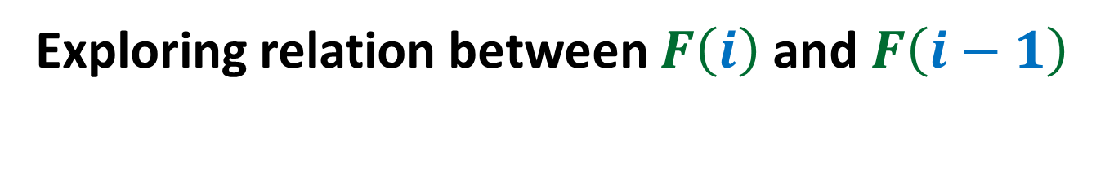



Exploring relation between $F\left(i\right)$ and $F\left(i−1\right)$
$$i$$
$$1$$
$$i−1$$
$$n$$
Observation: $f\left(i\right)$ $≤ f\left(i−1\right)+1$.
$$T$$
$$F\left(i−1\right)$$
$$F\left(i\right)$$
IMPOSSIBLE

Slide 36


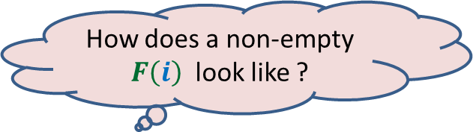

Exploring relation between $F\left(i\right)$ and $F\left(i−1\right)$
$$i$$
$$1$$
$$i−1$$
$$n$$
Theorem:
A non-empty $F\left(i\right)$ is of the form $X∷T[i]$, where
$X$is a prefix of $F\left(i−1\right)$
$$T$$
$$F\left(i−1\right)$$
$$F\left(i\right)$$
$$X$$
How does a non-empty $F\left(i\right)$ look like ?
that is also a suffix of $F\left(i−1\right)$.

Slide 37
To be continued from this point in the next lecture ☺

